Slide 1
STAT 717: Class 14
Discriminant Analysis
Vitaly Druker
December 11th, 2021

Slide 2
Introduction
Linear functions of variables are used to describe differences between two or more groups.
Identifying the relative contribution of the p variables to separation of the groups

Slide 3
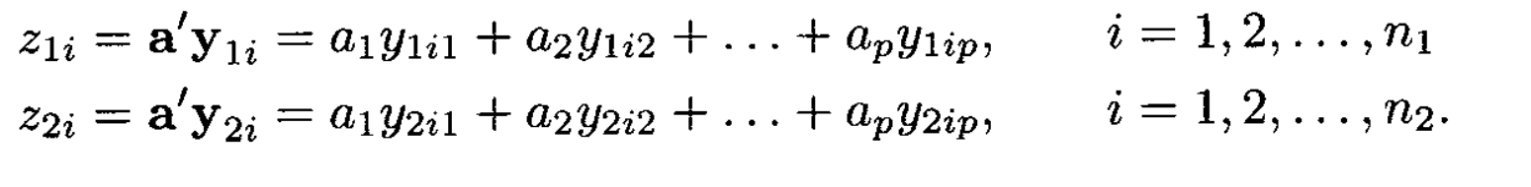
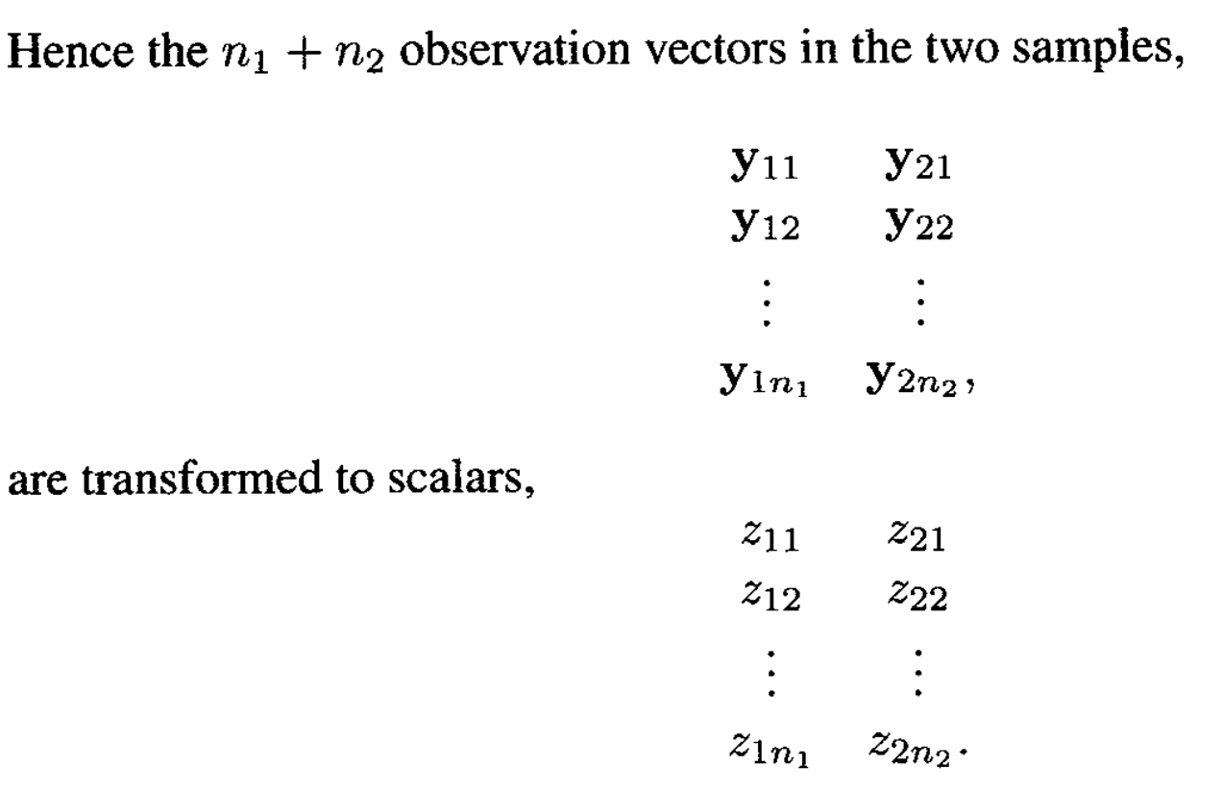
Discriminant function for two groups
Assume that the two populations to be compared have the same covariance matrix – but distinct mean vectors.

Slide 4
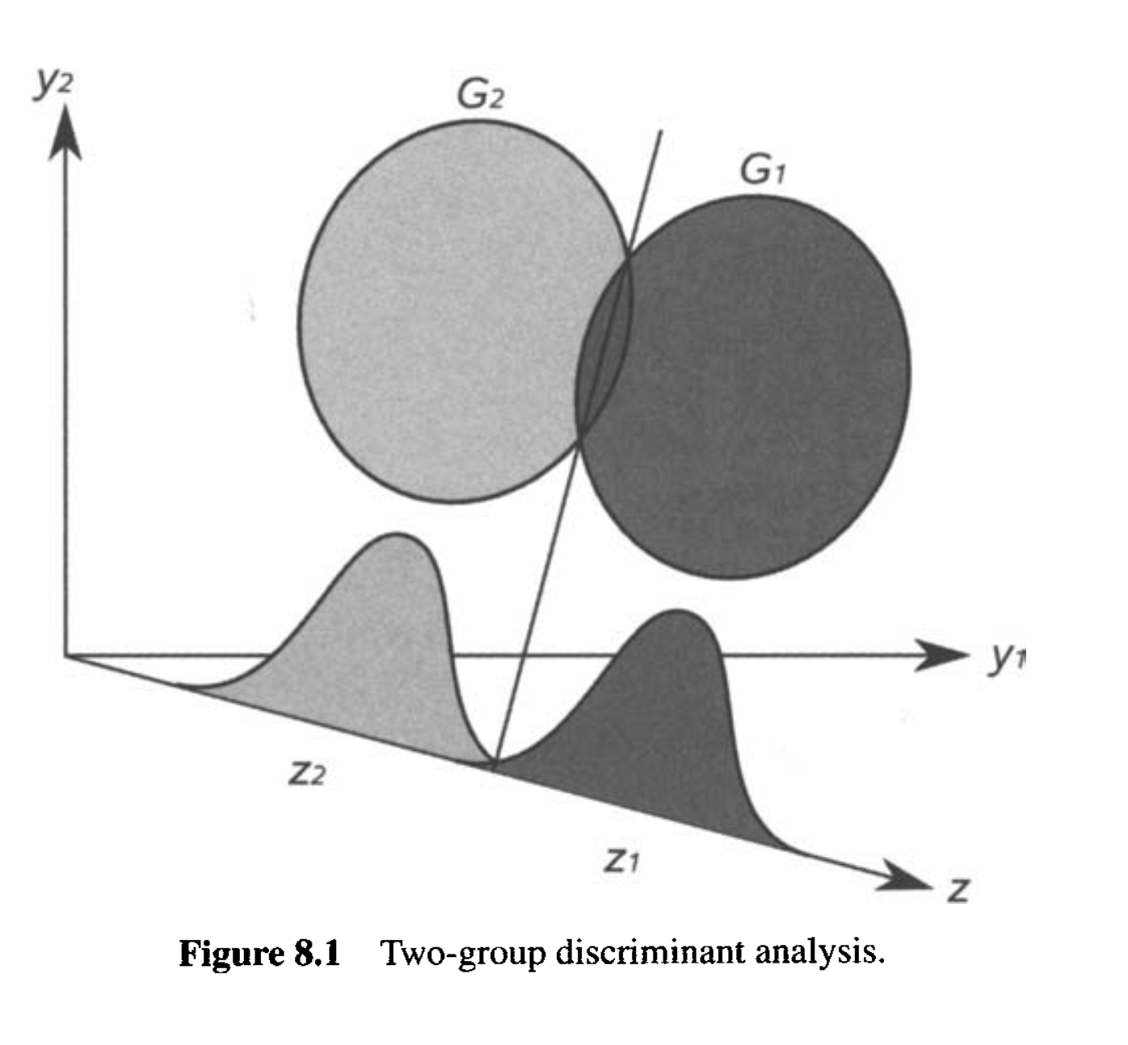

Slide 5
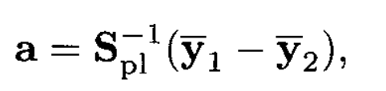
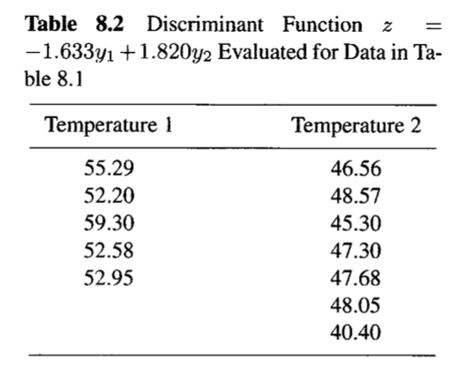
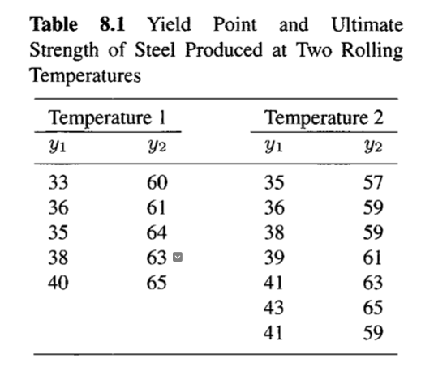
Separation is given by

Slide 6
Discriminant Analysis for Several groups
Extend previous idea to k groups
Examine group separation in a two-dimensional plot (we did this when we discussed clustering).
Find variables that best separate groups
Rank variables in terms of relative contribution
Interpret the new dimensions presented by the discriminate functions

Slide 7



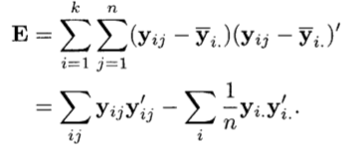

Slide 8

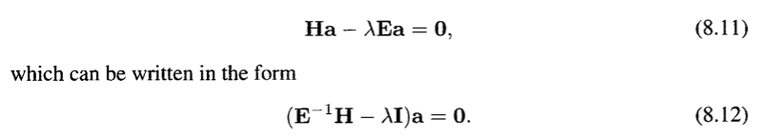
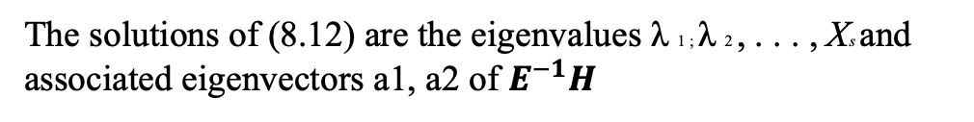
Continued
The solutions of (8.12) are the eigenvalues λ 1 ; λ 2 , . . . , Xs and associated eigenvectors a1, a2 of $E^{−1}H$

Slide 9
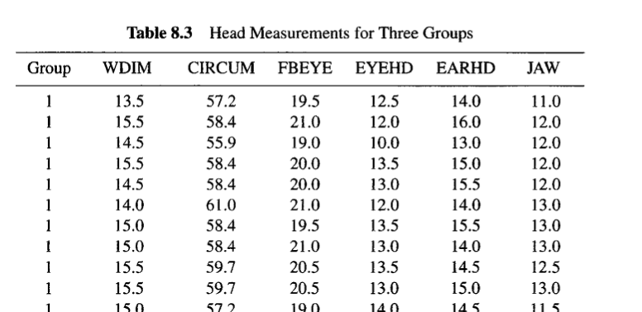
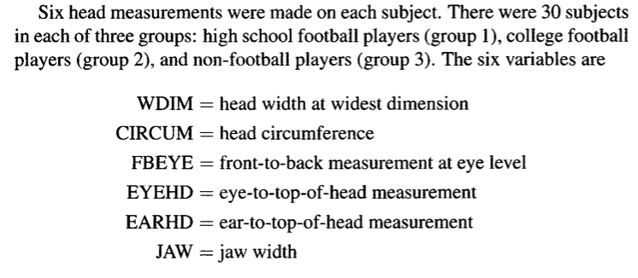
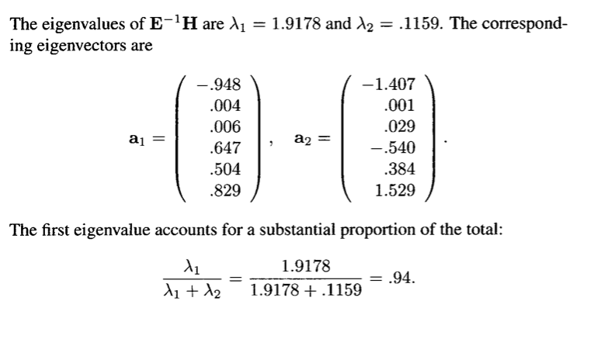

Slide 10

Measure of association for discriminant functions
It’s like an R squared value for the fit of discriminant functions

Slide 11
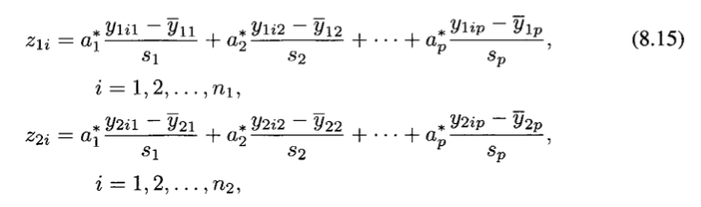
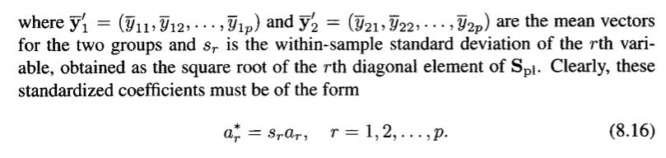

Standardized Discriminant Functions
Allows us to compare variable contributions

